Slide 1
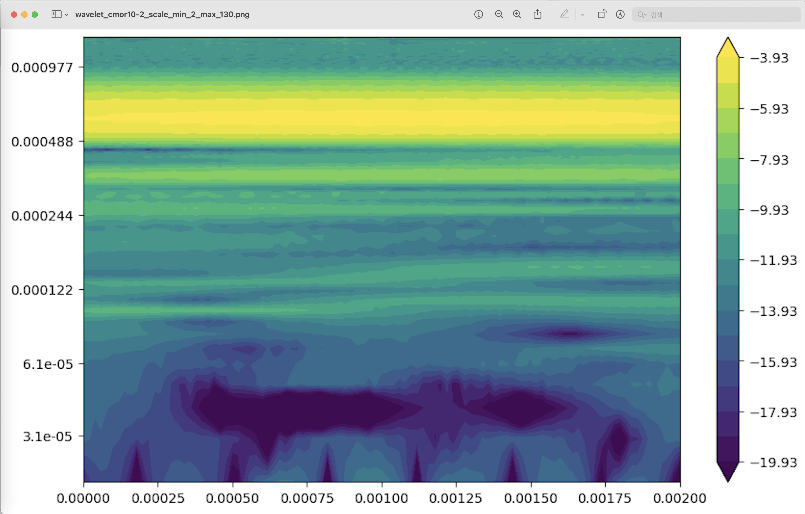
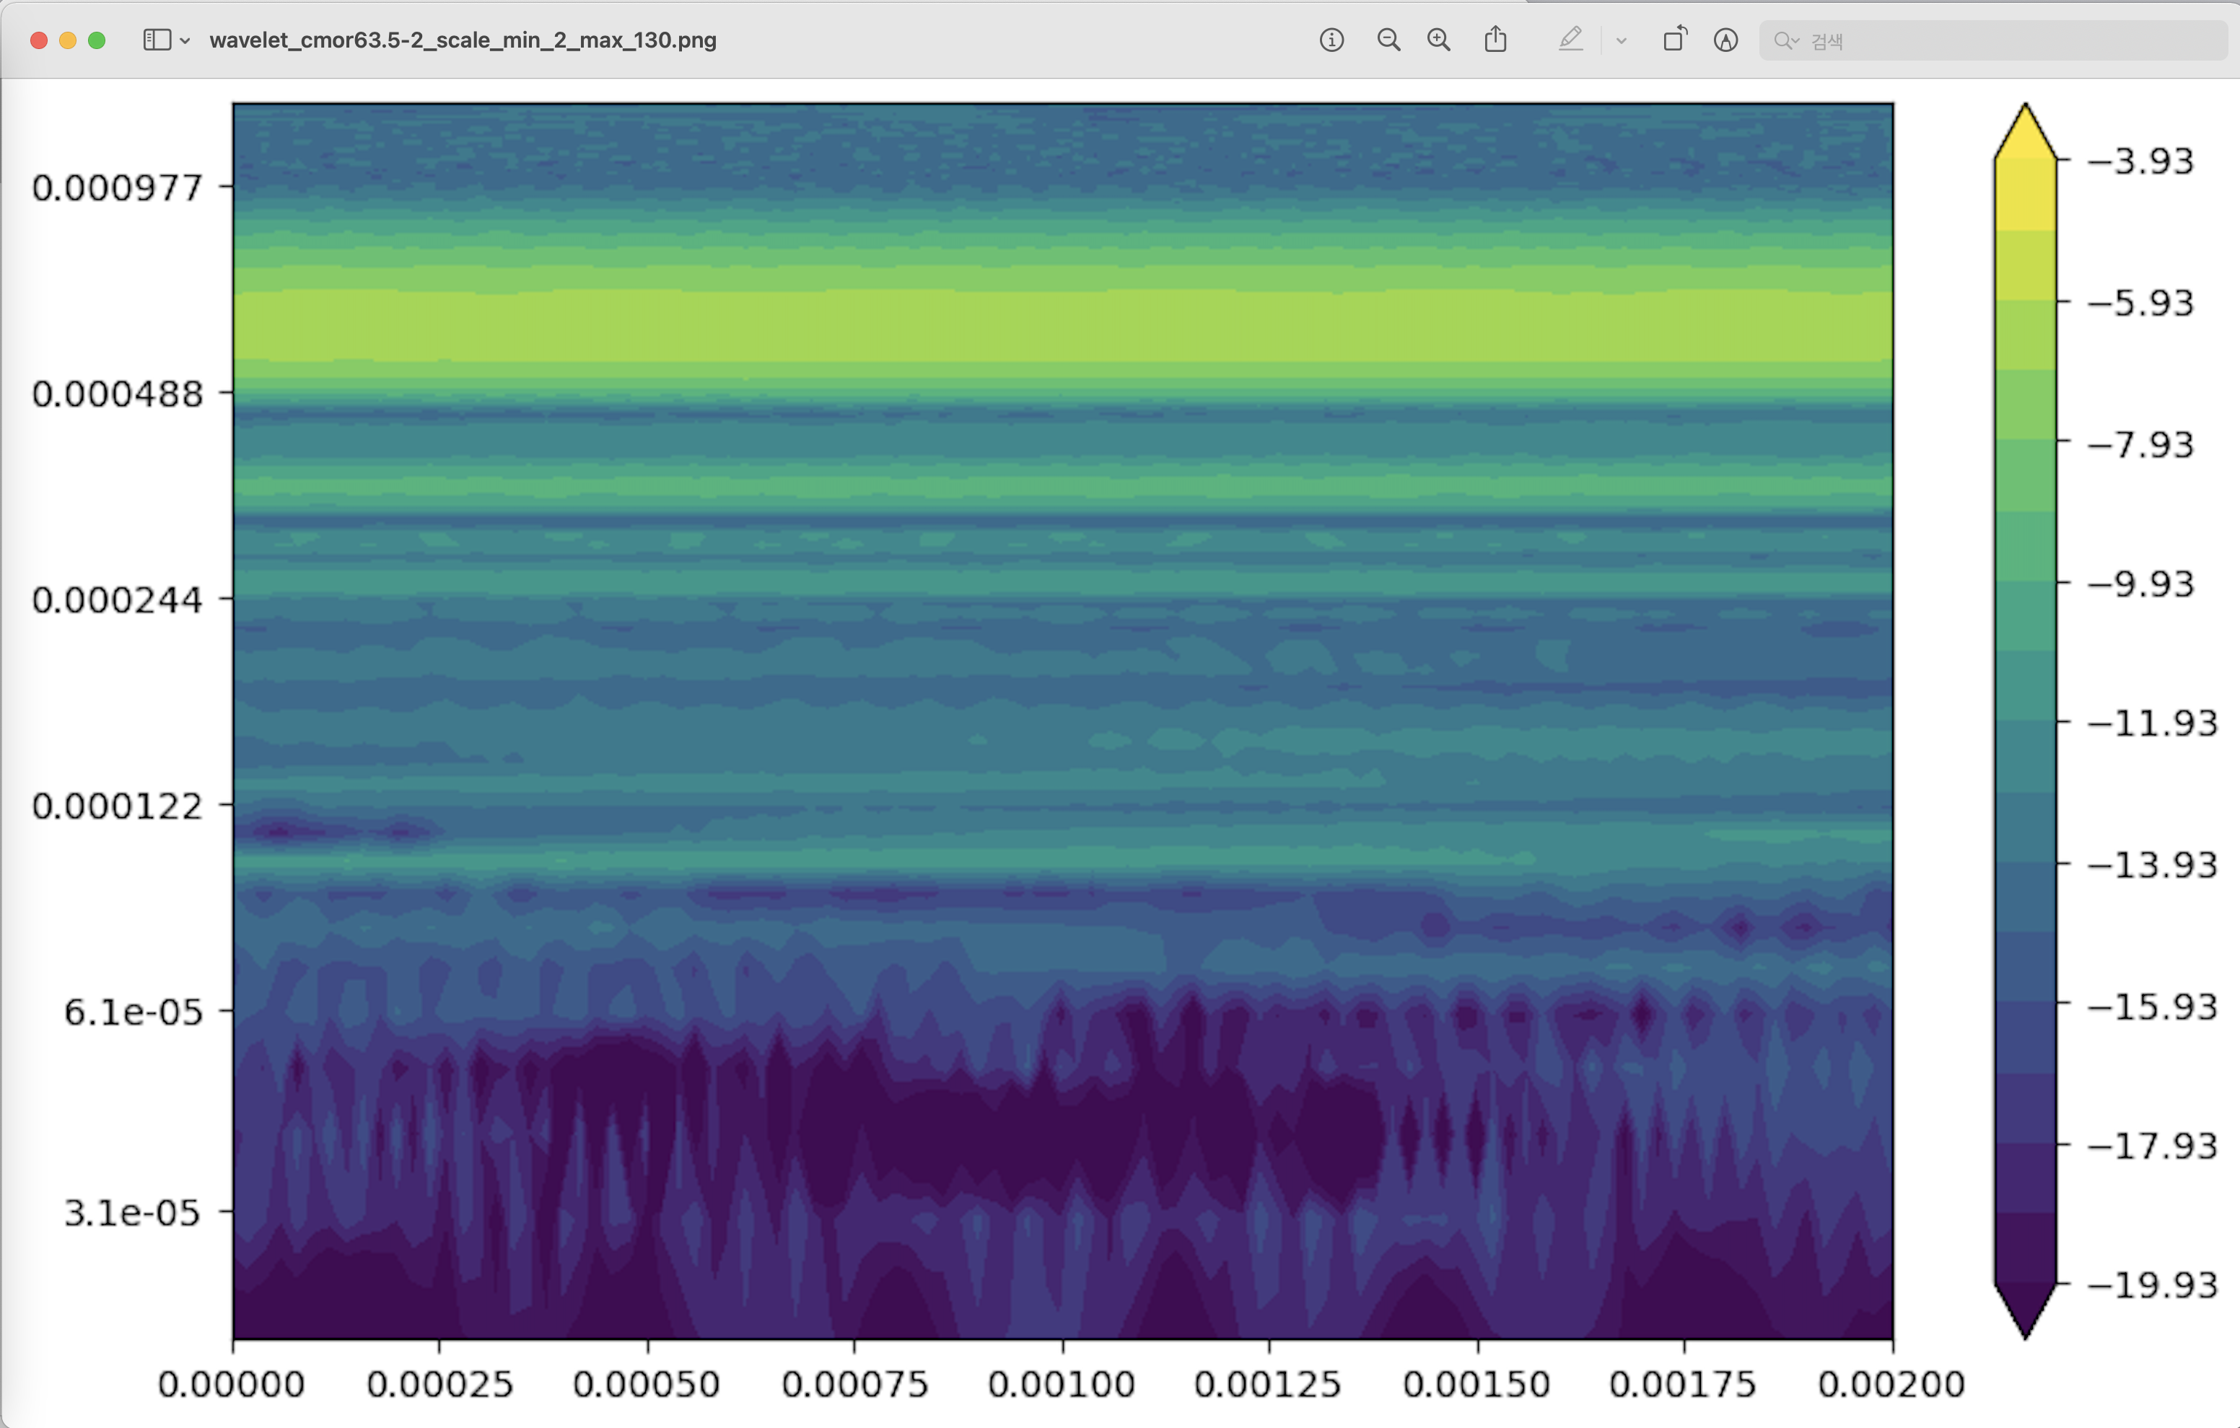
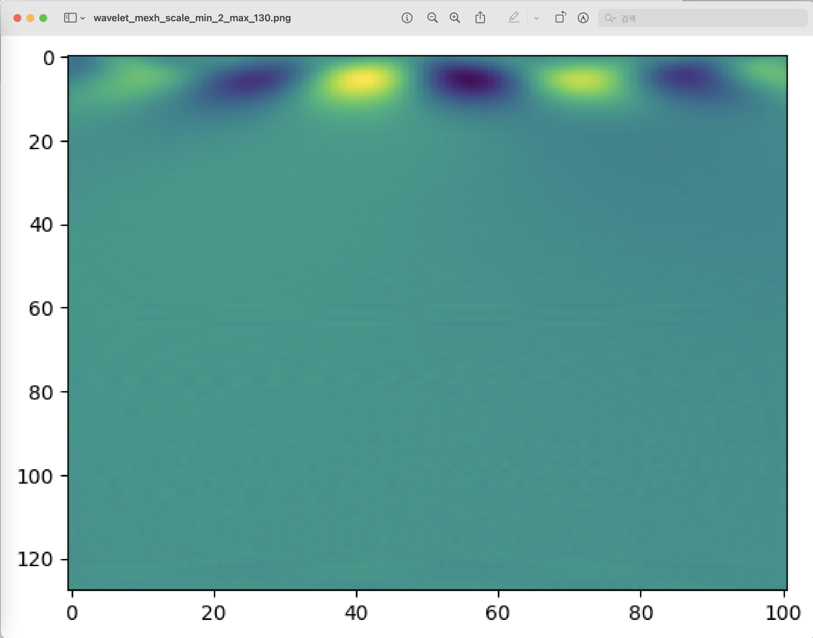
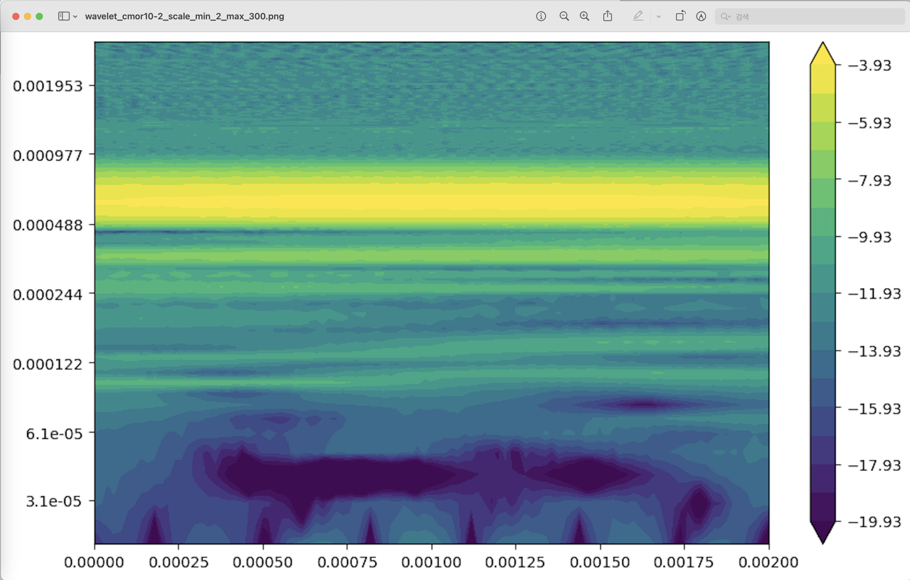
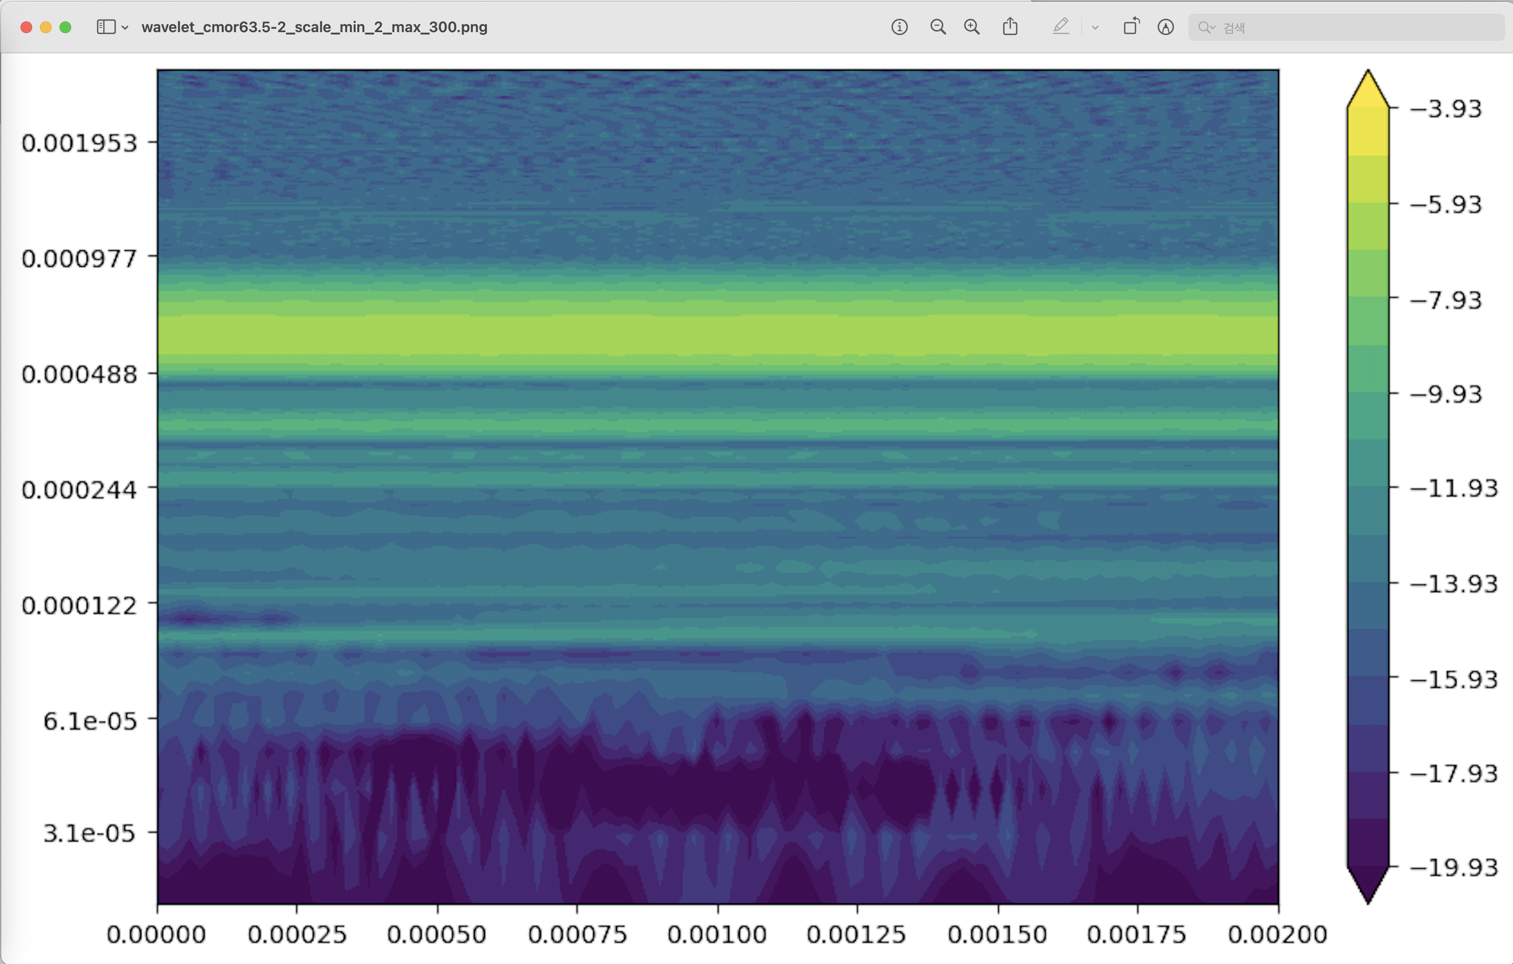
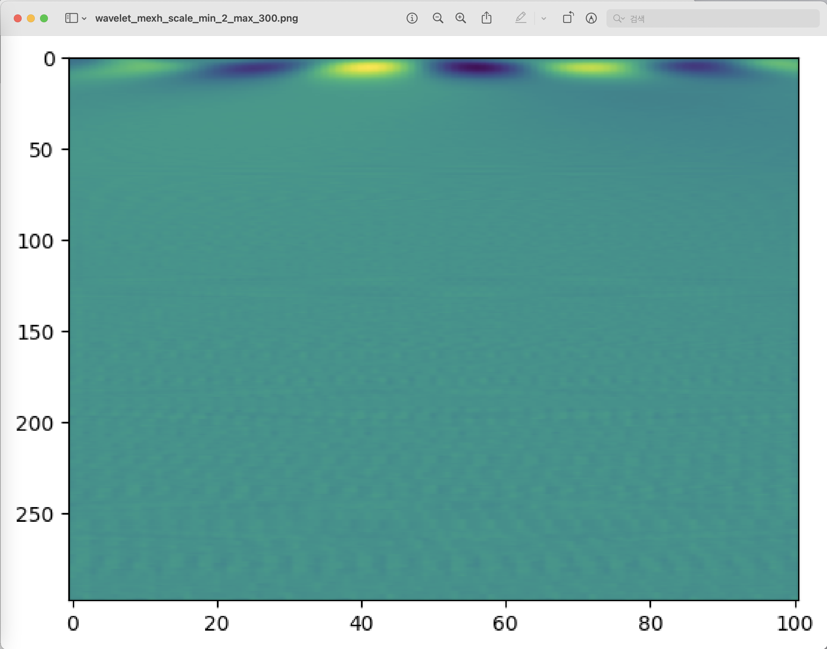
wavelet_cmor10-2_scale_min_2_max_130
wavelet_cmor10-2_scale_min_2_max_130
wavelet_cmor63.5-2_scale_min_2_max_130
wavelet_mexh_scale_min_2_max_130
Low freq (=long prd)
Low freq (=long prd)
Period
Period
Idx
High freq (=short prd)
High freq (=short prd)
wavelet_cmor10-2_scale_min_2_max_300
wavelet_cmor63.5-2_scale_min_2_max_300
wavelet_ mexh _scale_min_2_max_300
Period
Period
Idx

